Slide 1

Introduction to LUDES
Geraldo Xexéo, D.Sc.
(gxexeo@cos.ufrj.br, gxexeo@gmail.com)
Departamento de Ciência da Computação/ Instituto de Matemática
Programa de Engenharia de Sistemas e Computação/COPPE
UFRJ

Slide 2
Where we are
UFRJ
Federal University of Rio de Janeiro
Previously: University of Brazil
One of best Brazilian universities, 1st or 2nd accordingly to the chosen ranking
COPPE
Biggest Engineering Research Institute in Latin America
PESC
One of top Computer Science graduate course/research program in Brazil

Slide 3
What is in a name?
Ludology
the study of games and gaming
Engineering
the design and manufacture of complex products
Simulation
imitation or enactment, as of something anticipated or in testing
Although founded in 2010, LUDES got its new name and logo in 2014. Formerly it was known as CLUE

Slide 4
Main Goals
LUDES is a laboratory created to research Games and Simulations with the tools of Engineering, aiming to understand:
What is a game
Why people play games
What is quality for games
How to develop games
What are the impacts of games

Slide 5
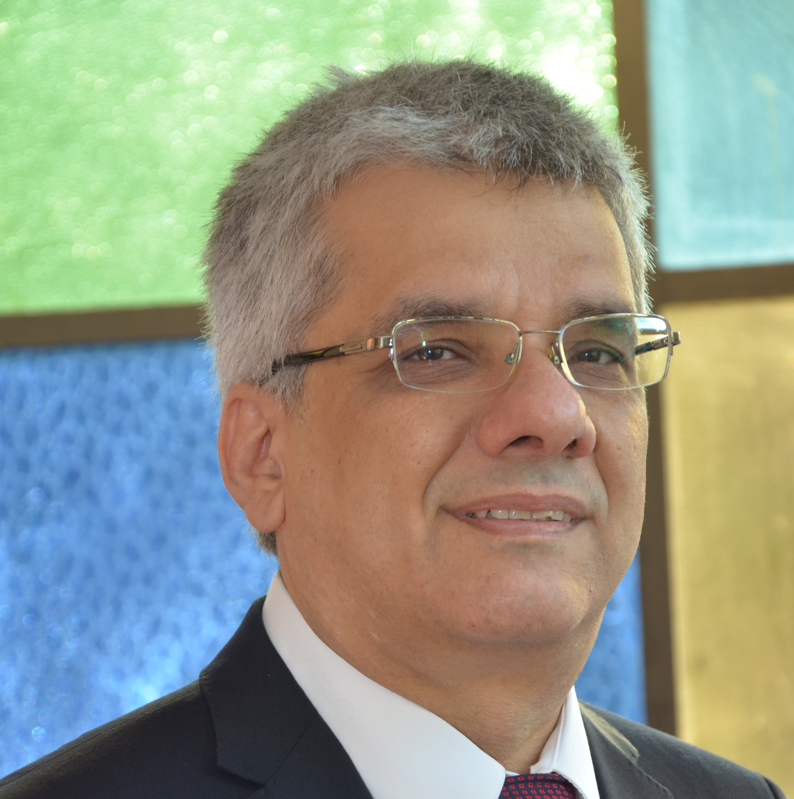

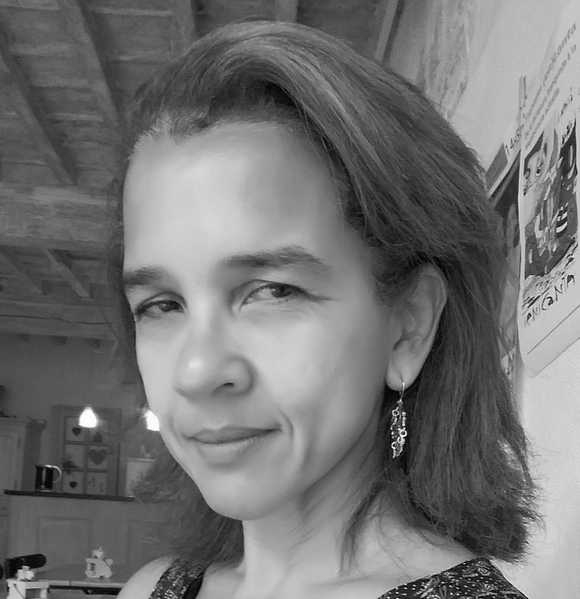


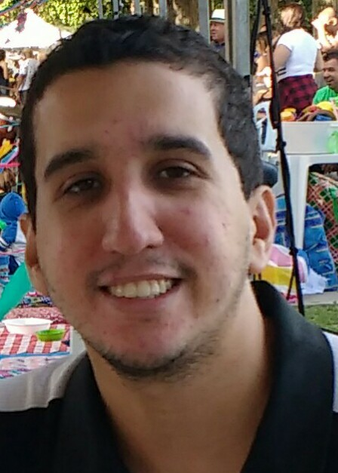
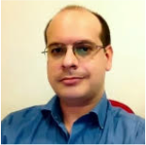

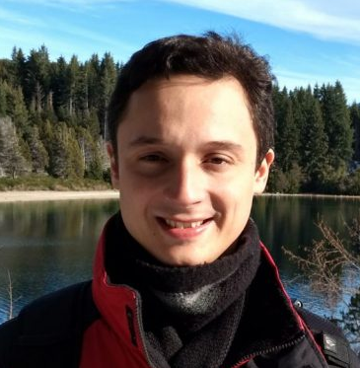

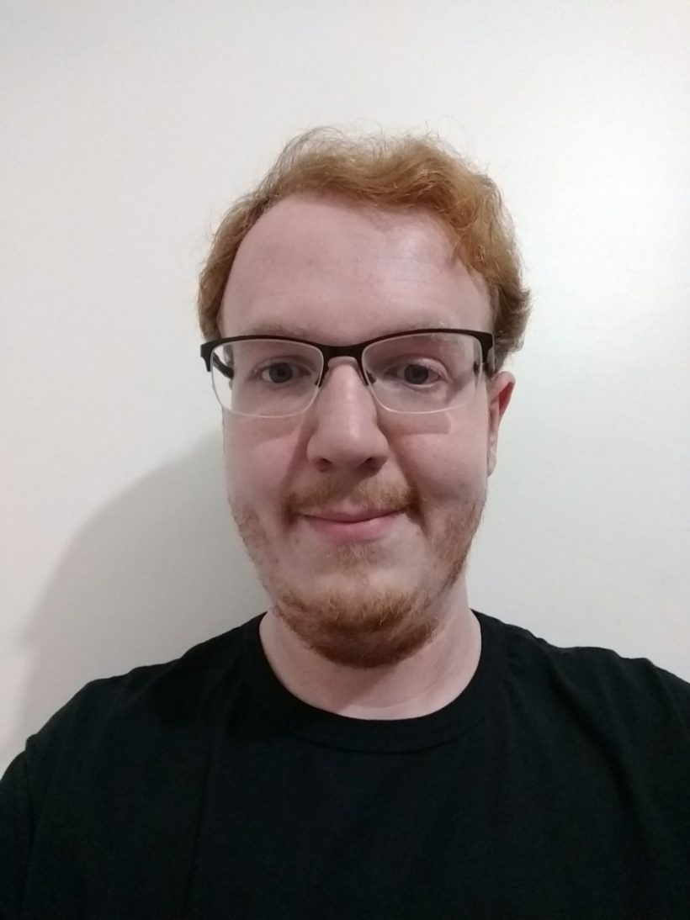
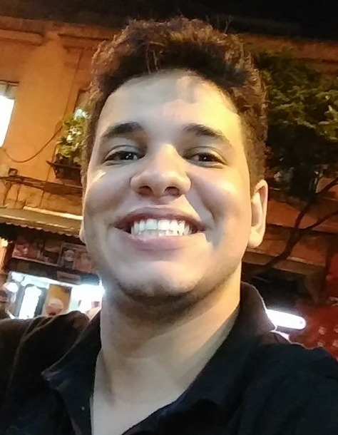

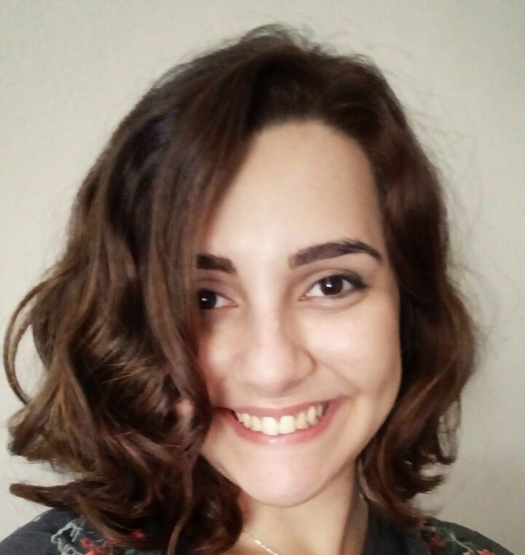
Who we are
Geraldo Xexéo
D.Sc.
Lab Leader
Claudio Dipolitto
D.Sc.
Renata Araújo
D.Sc.
D.Sc. Candidates
M.Sc. Candidates
Collaborators

Slide 6
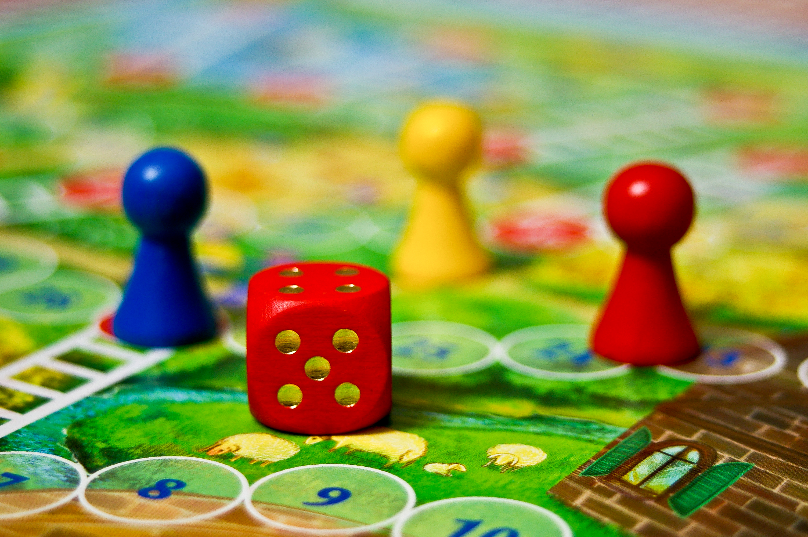
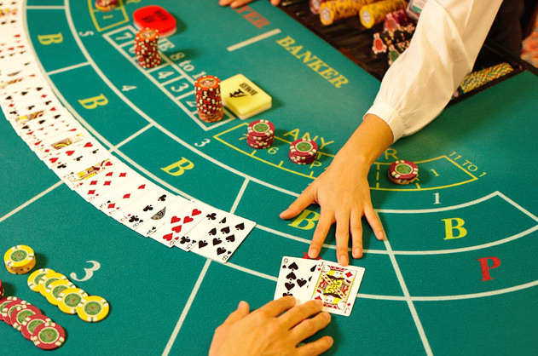
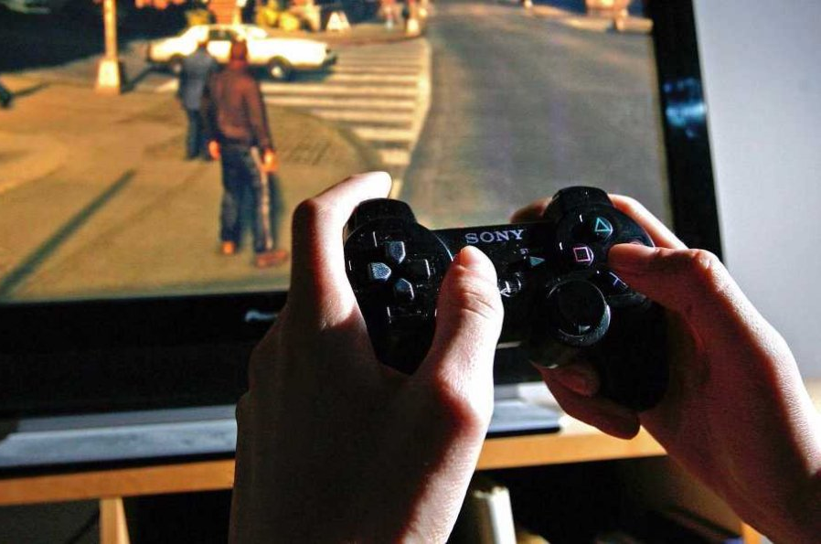
Games?

Slide 7
Current Areas of Research
Game Quality & Attractiveness
Game Development Process
Serious Games & Games with a Purpose

Slide 8
Game Quality & Attractiveness
Why and how people get interested in games
What keeps a person playing
How to adapt games on the fly to make them more attractive
How to measure game quality properties
Understanding gamer profiles
Sports/E-sports studies

Slide 9
Game Development Process
How to model games
How to automatically play games
General Game Playing
Testing games
Analyzing game logs
Game testing and development tools

Slide 10
Serious Games & Games with a Purpose
Developing games for business training
Channel’s Conquer (for Intelig)
How to develop a telecom representation
Kick-off TIM (for TIM Brasil)
How to manage a mobile retail franchise
The Boss
How to manage a software development company
The New Space Race
How new markets develop
Passing messages through games
Games for government

Slide 11
The Challenge of Gambling
How/What to research gambling in a public institution in Brazil?
The business of gambling
New forms of gambling
The engineering behind electronic gambling
Impacts on society
Fraud prevention and detection

Slide 12
LUDES.COS.UFRJ.BR
For papers, games and other work, please consult our website

